Slide 1
Chapter 6 The Determination of Wages

Slide 2
Chapter Summary
Wage determination is at the core of labor economics, since the structure of wages and the change in wages over time are responsible for efficiently allocating labor and maintaining a balance between demand and supply in the market.
In this chapter, several important issues of wage determination will be discussed such as the law of one wage in the competitive market, wage determination in the imperfect market, minimum wage, and efficiency wage theory, etc.

Slide 3
Wage Determination in Competitive Markets
There are five key assumptions in the model of perfect competition:
Business firms seek to maximize profit, and workers seek to maximize utility.
Workers and firms have perfect information about wages and job opportunities in the labor market.
Workers in the labor market are identical with respect skills and productivity, jobs offered by the firms are identical with respect to working condition and other nonwage attributes.

Slide 4
Wage Determination in Competitive Markets
The labor market is composed of many individual firms on buyer’s side of the market and many workers on the seller’s side. The workers do not belong to unions, and firms do not collude.
All jobs in the labor markets are open to competition by workers, no institutional barriers (for instance, seniority provision and internal hiring rules) inhibit mobility of workers from one job to another. Costs of mobility are zero.

Slide 5
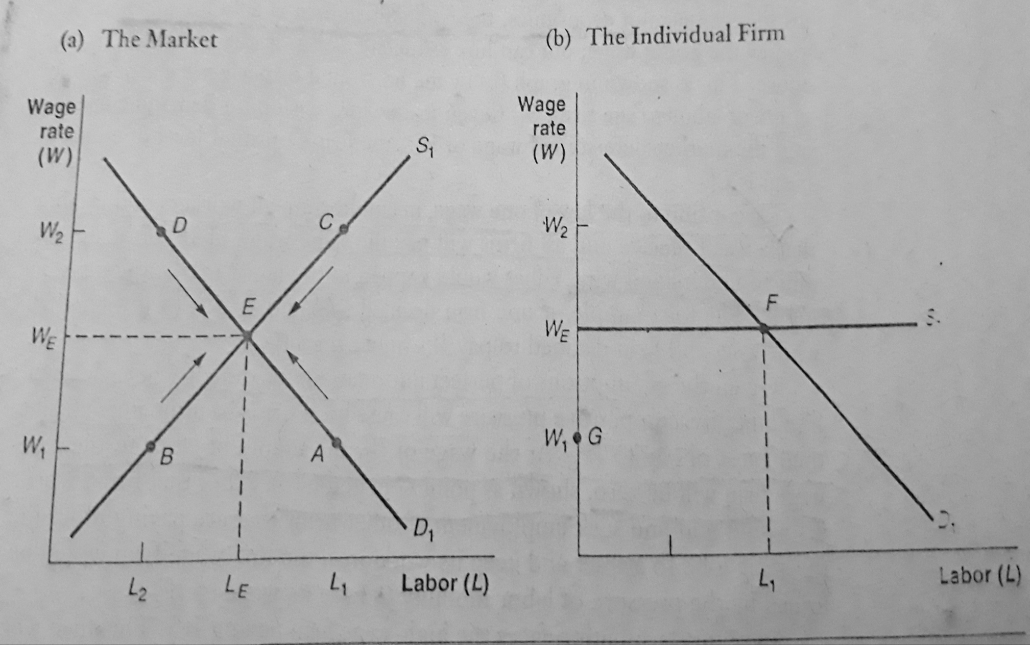
The Determination of Wages in a Perfectly Competitive Market

Slide 6
Market Imperfections
Why the labor market did not give rise to the predicted one wage?
Reason 1: the law of one wage describes a situation of long-run equilibrium, while real world labor market are in a constant state of change.
Reason 2.: sometimes market for different categories violates one or more of the five of the assumptions of the perfectly competitive model.

Slide 7
Market Imperfections
There are several reasons for market imperfection in the real world. Some of the following reasons are:
Non-maximizing Behavior
Imperfect Information
Heterogeneity of workers and jobs
Union and employer collusion
Costly mobility.

Slide 8
A More Realistic Model
Most real world labor markets feature imperfections such as non-maximizing behavior, limited information, and heterogeneous workers and jobs, that prevent the forces of competition and labor mobility from completely eliminating all wage differentials.
The dispersion of wage rates that results is illustrated in the figure shown on the following slide. The area of indeterminacy in wages is represented by the band extending from upper limit WU to the lower limit WL.

Slide 9
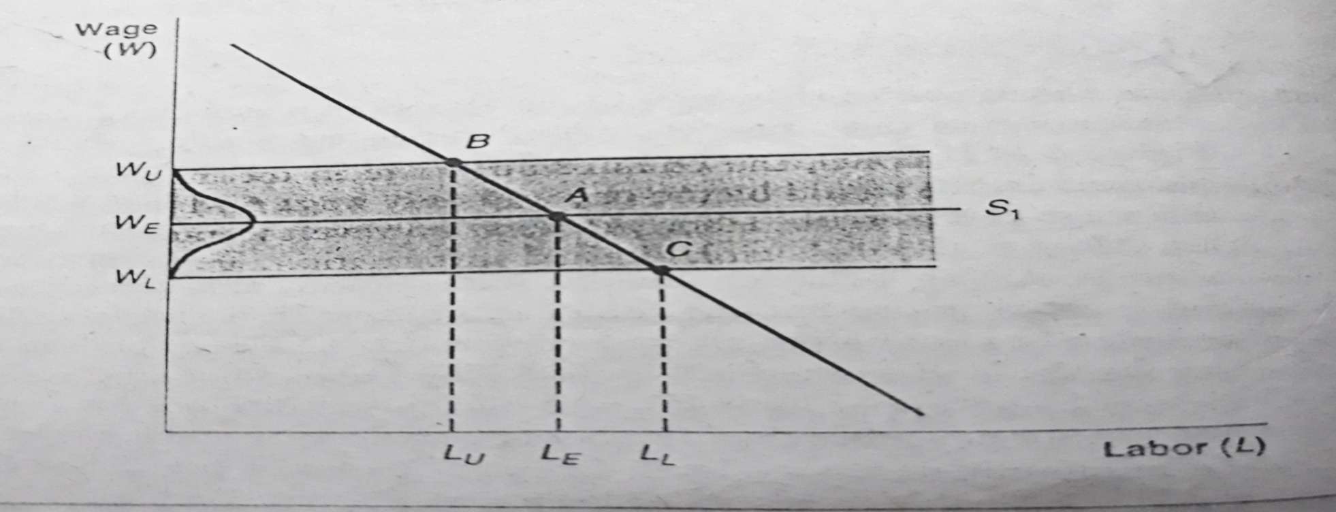
A More Realistic Model
The firm can not pay more than WU because to do so would lower its profits below minimum necessary level. Similarly, it cannot pay below WL because it would not be able to attract or keep a workforce. Most of the firm will pay close to going market wage WE.

Slide 10
Wage Determination in a Monopsony Market
The profit-maximizing level of employment for the monopsonist is the intersecting point of MCL schedule and MRP schedule.
Given that the firm desires to hire a specific level of employment, the supply curve shows that the firm must pay a wage to attract that many workers.
If the labor market were competitive, the wage rate and level of employment would be the point of crossing supply and MRPL (demand curve) curves.
The amount of monopsonistic exploitation is the difference between the value of what labor produces and what it is paid.

Slide 11
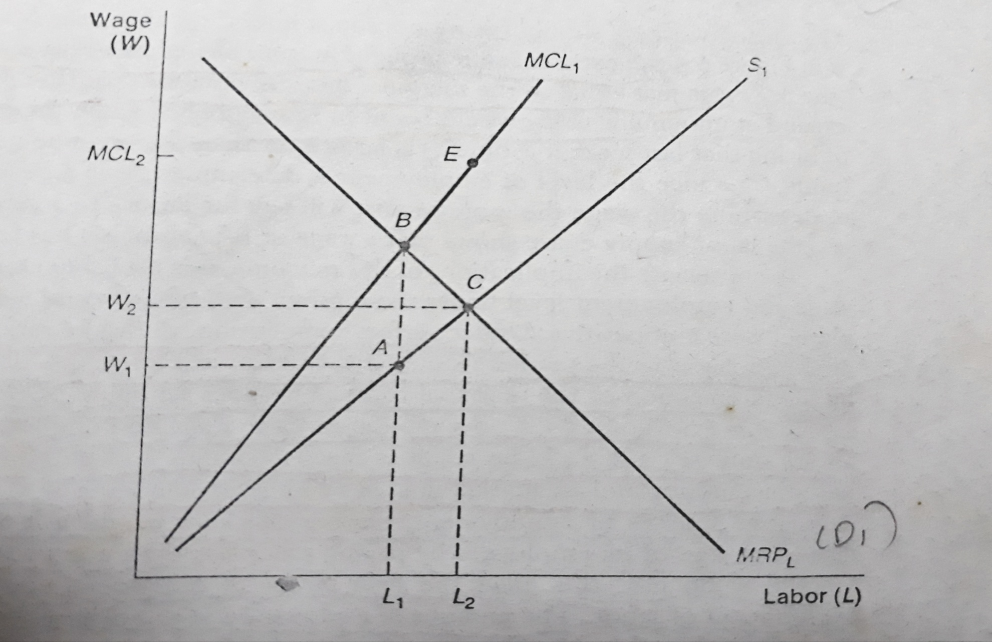
Wage Determination in a Monopsony Market

Slide 12
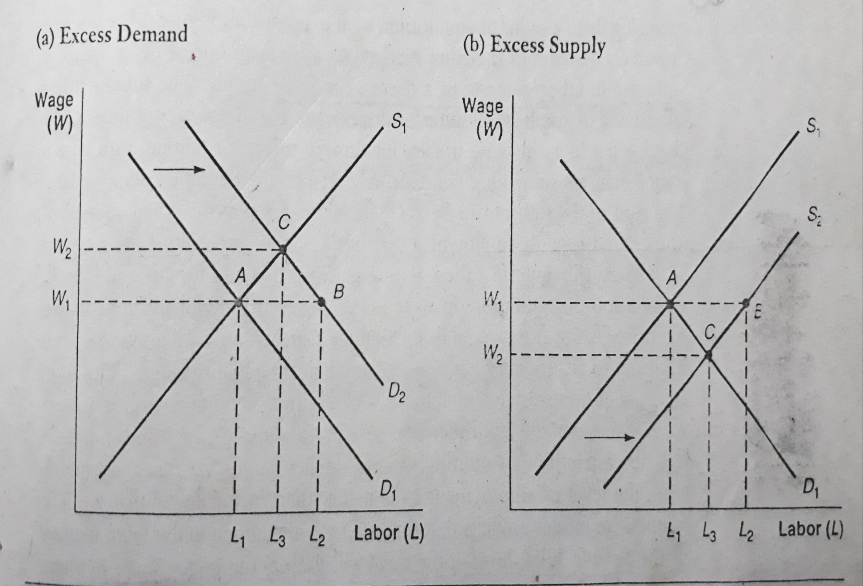
The Process of Market Adjustment

Slide 13
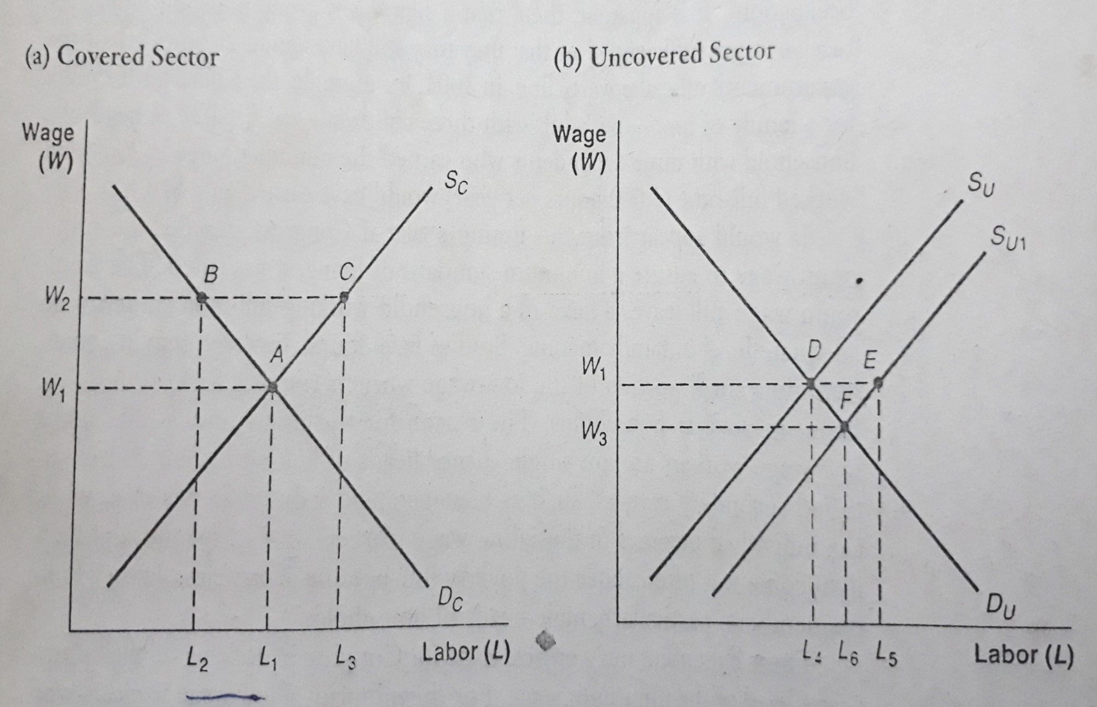
The Minimum Wage in a Perfectly Competitive Market

Slide 14
The Minimum Wage in a Perfectly Competitive Market
Q. Has the minimum wage law achieved its objective of raising the income of low-wage workers?

Slide 15
The Minimum Wage in a Perfectly Competitive Market
Q. Has the minimum wage law achieved its objective of raising the income of low-wage workers?
It depends on the elasticity of the demand curve in the covered sector. If labor demand is inelastic (Ed<1) the answer is yes; if it is elastic the answer is no.

Slide 16
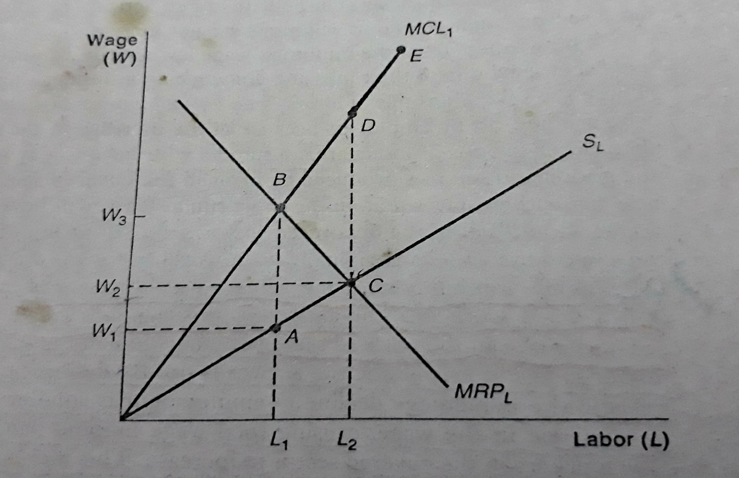
The Minimum Wage in a Monopsony Market

Slide 17
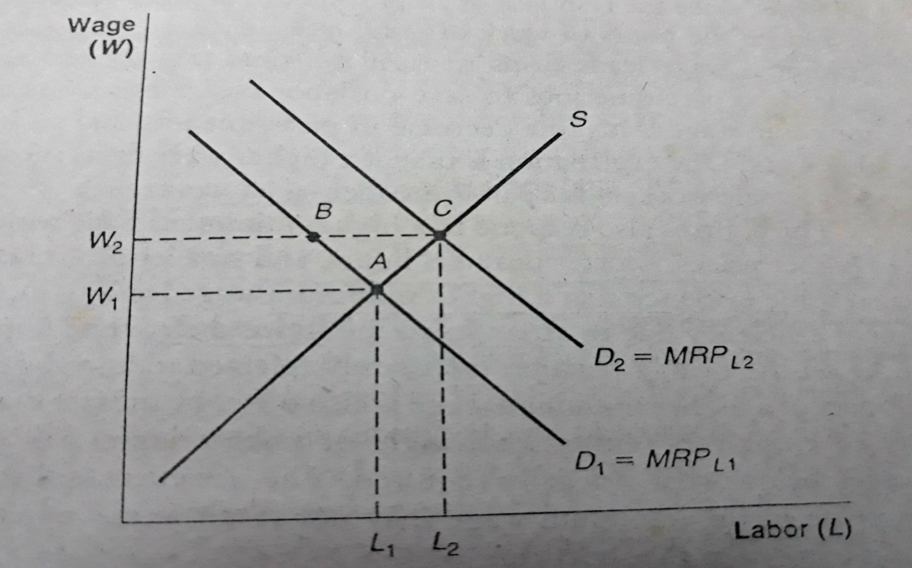
The Minimum Wage and Efficiency Wage Theory

